Slide 1
Implementation of Relational Operations
SUN YAT-SEN UNIVERSITY

Slide 2
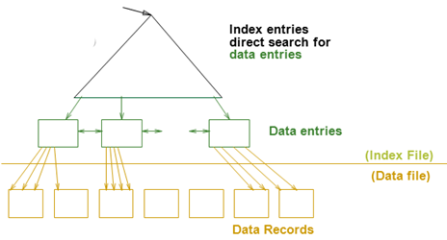
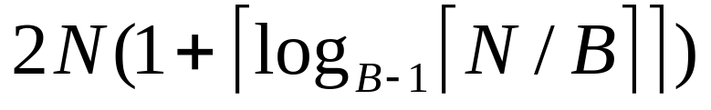
Review
Cost Model（代价模型）
  只关心磁盘块的IO次数
文件由页组成，而每个页包含一组记录
  Record id = <page id, slot #>
索引文件由两部份组成
  数据项部分
    Data Entry(数据项) data record（数据记录）
  引导部份
    树索引技术
    Hash索引
索引的 clustered？
外排序算法 COST=
Cost = log _{F} N (2~4 I/Os)
1~2 I/Os

Slide 3
Introduction
Next topic: QUERY PROCESSING(查询求值)
Some database operations are EXPENSIVE
Huge performance gained by being “smart”
  We’ll see 10,000x over naïve approach
Main weapons are:
  clever implementation techniques for operators
  Exploiting(利用) relational algebra “equivalences”
  using statistics and cost models to choose

Slide 4
Simple SQL Refresher
SELECT <list-of-fields>
FROM <list-of-tables>
WHERE <condition>
SELECT S.name, E.cid
FROM Students S, Enrolled E
WHERE S.sid=E.sid AND E.grade='A'

Slide 5
A Really Bad Query Optimizer
For each Select-From-Where query block
  Create a plan that:
    Forms the cross product
    of the FROM clause
    Applies the WHERE clause
(Then, as needed:
  Apply the GROUP BY clause
  Apply the HAVING clause
  Apply any projections and output expressions
  Apply duplicate elimination and/or ORDER BY)
SELECT S.name, E.cid
FROM Students S, Enrolled E
WHERE S.sid=E.sid AND E.grade='A'
σ_{predicates}
×
…
_{tables}

Slide 6
Cost-based Query Sub-System
SELECT S.name, E.cid
FROM Students S, Enrolled E
WHERE S.sid=E.sid AND E.grade='A'
Queries
Query Parser
σ-π-×关系代数表达式
Query Optimizer
Plan Generator
Plan Cost Estimator
Catalog Manager
Schema
Statistics
Query Plan Evaluator

Slide 7
The Query Optimization Game
Goal is to pick a “good” plan
  Good = low expected cost, under cost model
  Degrees of freedom:
    access methods
    physical operators
    operator orders
Roadmap for this topic:
  First: implementing individual operators
  Then: optimizing multiple operators
σ_{predicates}
×
…
_{tables}

Slide 8

Relational Operations
We will consider how to implement:
  Selection ( σ ) Select a subset of rows.
  Projection ( π ) Remove unwanted columns.
  Join ( ) Combine two relations.
  Set-difference ( − ) Tuples in reln. 1, but not in reln. 2.
  Union ( ∪ ) Tuples in reln. 1 and in reln. 2.
Q: What about Intersection?
R∩S=R-(R-S)
Notes:
R∩S=R-(R-S)

Slide 9
Schema for Examples
Sailors (sid: integer, sname: string, rating: integer, age: real)
Reserves (sid: integer, bid: integer, day: dates, rname: string)
Sailors:
  Each tuple is 50 bytes long, 80 tuples per page, 500 pages.
  [S]=500, p_{S}=80.
Reserves:
  Each tuple is 40 bytes, 100 tuples per page, 1000 pages.
  [R]=1000, p_{R}=100.

Slide 10
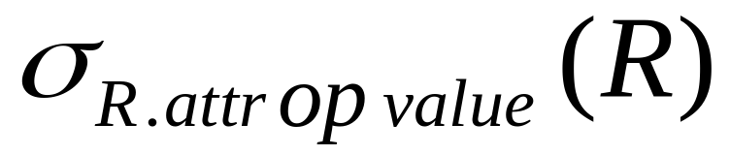
Simple Selections
SELECT *
FROM Reserves R
WHERE R.rname < ‘C%’
How best to perform? Depends on:
  what indexes are available
  expected size of result
Size of result approximated as
(size of R) * selectivity
  Selectivity(选择性/缩减因子) estimated via statistics – we will discuss shortly.
Notes:
11

Slide 11
Our options …
If no appropriate index exists:
  Must scan the whole relation
  cost = [R].
  For “reserves” = 1000 I/Os.
SELECT *
FROM Reserves R
WHERE R.rname < ‘C%’
  [S]=500, p_{S}=80.
  [R]=1000, p_{R}=100

Slide 12
Our options …
SELECT *
FROM Reserves R
WHERE R.rname < ‘C%’
With index on selection attribute:
  1. Use index to find qualifying data entries
  2. Retrieve corresponding data records
  Total cost = cost of step 1 + cost of step 2
  For “Reserves”, if selectivity = 10% (100 pages, 100*100 tuples):
    If clustered index, cost is a little over 100 I/Os;
    If unclustered, could be up to 100*100 I/Os! … unless …
  [S]=500, p_{S}=80.
  [R]=1000, p_{R}=100
Index entries
UNCLUSTERED
CLUSTERED
direct search for
data entries
Data entries
Data entries
(Index File)
(Data file)
Data Records
Data Records

Slide 13
Refinement for unclustered indexes
SELECT *
FROM Reserves R
WHERE R.rname < ‘C%’
  1. Find qualifying data entries.
  2. Sort the rids of the data records to be retrieved.
  3. Fetch rids in order.
  Each data page is looked at just once (though # of such pages likely to be higher than with clustering).
  [S]=500, p_{S}=80.
  [R]=1000, p_{R}=100
100*100 I/Os
UNCLUSTERED
Data entries
(Index File)
(Data file)
Data Records

Slide 14
General Selection Conditions
(day<8/9/94 AND rname=‘Paul’) OR bid=5 OR sid=3
First, convert to conjunctive normal form (CNF)-合取范式:
  (day<8/9/94 OR bid=5 OR sid=3 ) AND
  (rname=‘Paul’ OR bid=5 OR sid=3)
We only discuss the case with no ORs
Terminology – 索引匹配选择条件:
  A B-tree index matches terms(合取体) that involve only attributes in a prefix of the search key. e.g.:
  Index on <a, b, c> matches a=5 AND b= 3, but not b=3.
Notes:
13

Slide 15
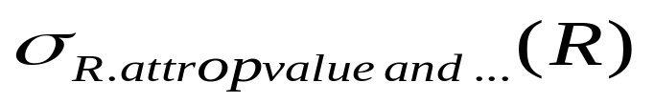
2 Approaches to General Selections
Approach I:
Find the cheapest access path(访问路径)
retrieve tuples using it
Apply any remaining terms that don’t match the index
    Cheapest access path: An index or file scan that we estimate will require the fewest page I/Os.
Notes:
14

Slide 16
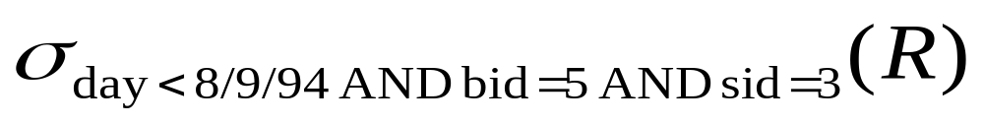
Cheapest Access Path - Example
query:
some options:
B+tree index on day; check bid=5 and sid=3 afterward.
hash index on <bid, sid>; check day<8/9/94 afterward.
How about a B+tree on <rname, day>?
How about a B+tree on <day, rname>?
How about a Hash index on <day, rname>?

Slide 17
2 Approaches to General Selections (Contd.)
Approach II: use 2 or more matching indexes.
1. From each index, get set of rids
2. Compute intersection of rid sets
3. Retrieve records for rids in intersection
4. Apply any remaining terms
  EXAMPLE:
  Suppose we have an index on day, and another index on sid.
  Get rids of records satisfying day<8/9/94.
  Also get rids of records satisfying sid=3.
  Find intersection, then retrieve records, then check bid=5.
Notes:
15

Slide 18
Projection
SELECT DISTINCT
R.sid, R.bid
FROM Reserves R
Issue is removing duplicates.
Use sorting!!
  1. Scan R, extract only the needed attributes
  2. Sort the resulting set
  3. Remove adjacent duplicates
  Cost:
  writes to temp table at each step!
  Reserves with size ratio 0.25 = 250 pages.
  With 20 buffer pages can sort in 2 passes, so: 1000 +250 + 2 * 2 * 250 + 250 = 2500 I/Os
  [S]=500, p_{S}=80.
  [R]=1000, p_{R}=100
Notes:
16

Slide 19
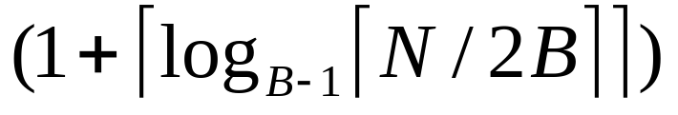
Projection -- improved
SELECT DISTINCT
R.sid, R.bid
FROM Reserves R
Avoid the temp files, work on the fly:
  Modify Pass 0 of sort to eliminate unwanted fields.
  Modify Passes 1+ to eliminate duplicates.
  Cost:
  Reserves with size ratio 0.25 = 250 pages.
  With 20 buffer pages can sort in 2 passes, so:
    Read 1000 pages
    Write 250 (in runs of 40 pages each) = 7 runs
    Read and merge runs (20 buffers, so 1 merge pass!)
  Total cost = 1000 + 250 +250 = 1500.
  [S]=500, p_{S}=80.
  [R]=1000, p_{R}=100
  1000 +250 + 2 * 2 * 250 + 250 = 2500 I/Os

Slide 20


Other Projection Tricks
  [S]=500, p_{S}=80.
  [R]=1000, p_{R}=100
If an index search key contains all wanted attrs:
Do index-only (唯索引)scan
  Apply projection techniques to data entries (much smaller!)
If a B+Tree index search key prefix has all wanted attrs:
Do in-order index-only (有序唯索引) scan
  Compare adjacent tuples on the fly (no sorting required!)
Notes:
18

Slide 21

Joins
SELECT *
FROM Reserves R1, Sailors S1
WHERE R1.sid=S1.sid
Joins are very common.
R S is large; so, R S followed by a selection is inefficient.
Many approaches to reduce join cost.
  Join techniques we will cover today:
    Nested-loops join
    Index-nested loops join
    Sort-merge join

Slide 22
Simple Nested Loops Join
(简单的嵌套循环连接算法)
  [S]=500, p_{S}=80.
  [R]=1000, p_{R}=100
R S:
foreach tuple r in R do
foreach tuple s in S do
if r_{i} == s_{j} then add <r, s> to result
Cost = [R] + (p_{R}*[R])*[S] = 1000 + 100*1000*500 IOs
  At 10ms/IO, Total time: ???
What if smaller relation (S) was “outer”?
What assumptions are being made here?
What is cost if one relation can fit entirely in memory?
=1000 + 50000000 IOs
140小时
[S] + (p_{S}*[S])*[R]
500 + 80*500*1000
Not all in memory
[R] + [S]

Slide 23
Page-Oriented Nested Loops Join
(页嵌套循环连接算法)
foreach page b_{R} in R do
foreach page b_{S} in S do
foreach tuple r in b_{R} do
foreach tuple s in b_{S}do
if r_{i} == s_{j} then add <r, s> to result
R S:
  [S]=500, p_{S}=80.
  [R]=1000, p_{R}=100
Cost = [R] + [R] *[S] = 1000 + 1000*500=501000
If smaller relation (S) is outer, cost = 500 + 500*1000
=500500
Much better than naïve per-tuple approach!
1小时
1%

Slide 24
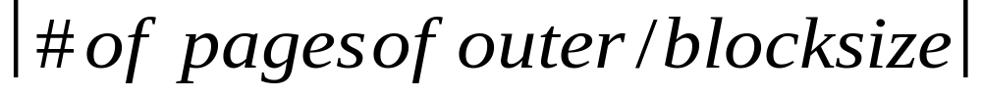
Block Nested Loops Join
(块嵌套循环连接算法)
foreach block b_{R} in R do
foreach page b_{S} in S do
…
Cost = [R] + [R] *[S]
Page-oriented NL doesn’t exploit extra buffers :(
Idea to use memory efficiently:
R & S
Join Result
block of R tuples
(B-2 pages)
. . .
. . .
. . .
Input buffer for S
Output buffer
Cost: Scan outer + (#outer blocks * scan inner)
  #outer blocks =
Cost = [R] + [R]/N *[S]

Slide 25
Examples of Block Nested Loops Join
foreach block b_{R} in R do
foreach page b_{S} in S do
…
Say we have B = 100+2 memory buffers
Join cost = [outer] + (#outer blocks * [inner])
  #outer blocks = [outer] / 100
With R as outer ([R] = 1000):
  Scanning R costs 1000 IO’s (done in 10 blocks)
  Per block of R, we scan S; costs 10*500 I/Os
  Total = 1000 + 10*500=6000.
With S as outer ([S] = 500):
  Scanning S costs 500 IO’s (done in 5 blocks)
  Per block of S, we can R; costs 5*1000 IO’s
  Total = 500 + 5*1000=5500.
Cost = [R] + [R]/N *[S]
  [S]=500, p_{S}=80.
  [R]=1000, p_{R}=100
55秒
1/10000

Slide 26
Index Nested Loops Join
(索引嵌套循环连接算法)
R S:
foreach tuple r in R do
foreach tuple s in S where r_{i} == s_{j} do
add <r, s> to result
lookup(r_{i})
R:
r_{i}
INDEX on S
Data entries
S:
s_{j}
Data Records

Slide 27
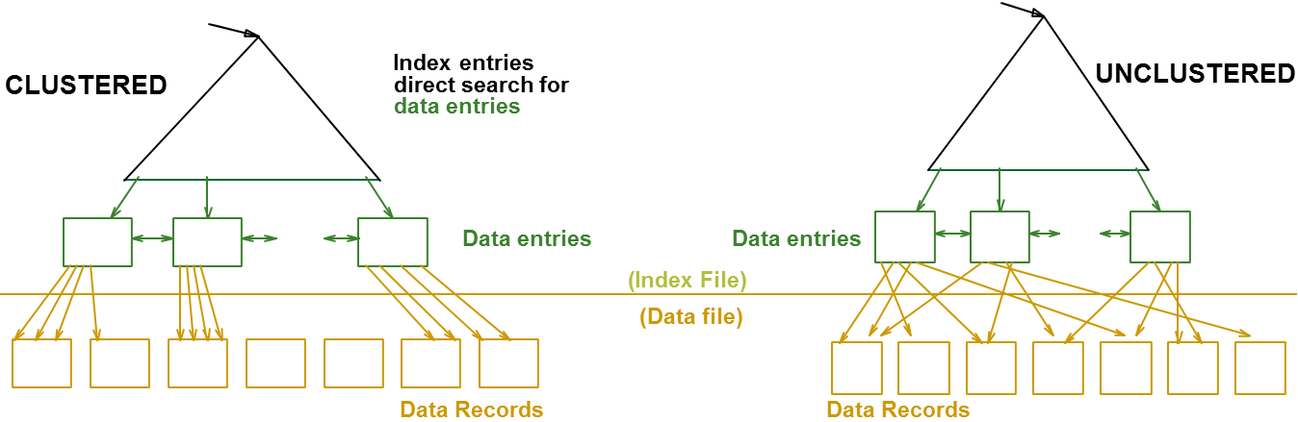
Index Nested Loops Join
  [S]=500, p_{S}=80.
  [R]=1000, p_{R}=100
R S:
foreach tuple r in R do
foreach tuple s in S where r_{i} == s_{j} do
add <r, s> to result
Cost = [R] + ([R]*p_{R}) * cost to find matching S tuples
  If index uses Alt. 1, cost = cost to traverse tree from root to leaf.
  For Alt. 2 or 3:
    Cost to lookup RID(s); typically 2-4 IO’s for B+Tree.
    Cost to retrieve records from RID(s); depends on clustering.
      Clustered index: 1 I/O per page of matching S tuples.
      Unclustered: up to 1 I/O per matching S tuple.

Slide 28
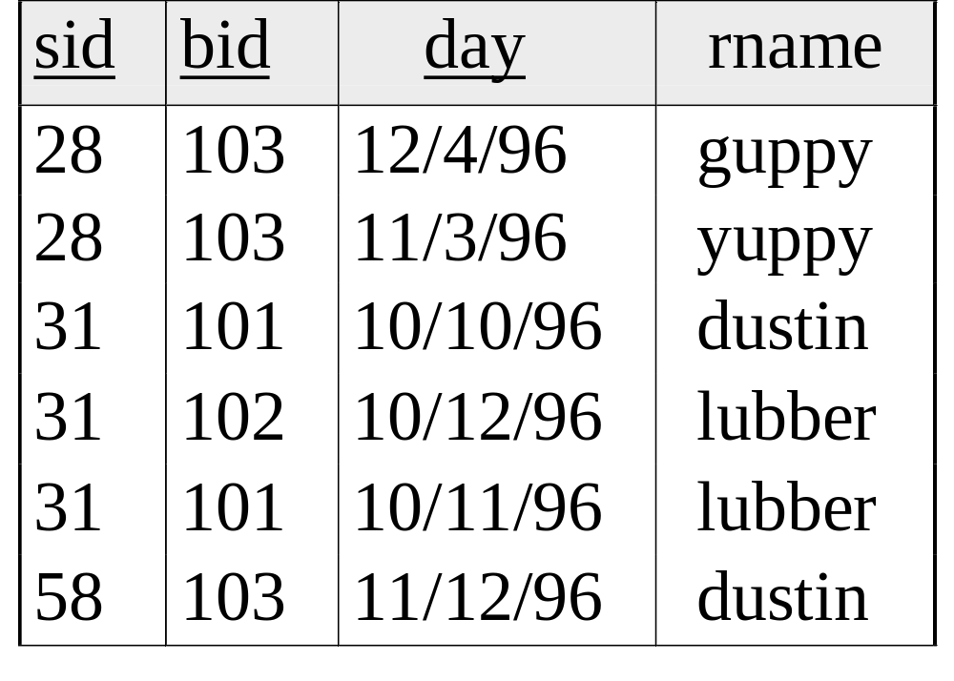
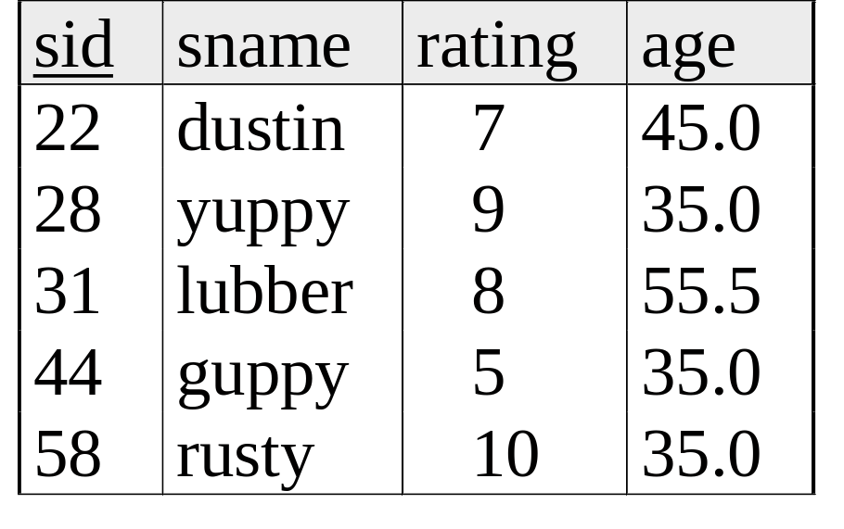
Sort-Merge Join
(排序归并连接算法)
  Sort R on join attr(s)
  Sort S on join attr(s)
  Scan sorted-R and sorted-S in tandem, to find matches
Example:
SELECT *
FROM Reserves R1, Sailors S1
WHERE R1.sid=S1.sid

Slide 29
Cost of Sort-Merge Join
  [S]=500, p_{S}=80.
  [R]=1000, p_{R}=100
Cost: Sort R + Sort S + ([R]+[S])
  But in worst case, last term could be [R]*[S] (very unlikely!)
  Q: what is worst case?
Suppose B = 35 buffer pages:
Both R and S can be sorted in 2 passes
Total join cost = 4*1000 + 4*500 + (1000 + 500) = 7500
Suppose B = 300 buffer pages:
Again, both R and S sorted in 2 passes
Total join cost = 7500
Join cost = [outer] + (#outer blocks * [inner])
500+500/（35-2）*1000
500+500/（300-2）*1000
Block-Nested-Loop cost = 2500 … 15,000

Slide 30
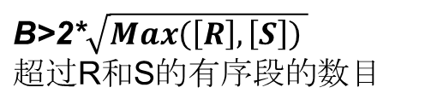
Other Considerations …
  [S]=500, p_{S}=80.
  [R]=1000, p_{R}=100
1. An important refinement:
  Do the join during the final merging pass of sort !
  If have enough memory, can do:
  1. Read R and write out sorted runs
  2. Read S and write out sorted runs
  3. Merge R-runs and S-runs, while finding R S matches
  Cost = 3*[R] + 3*[S]
  Q: how much memory is “enough” ?
>
<
2. Sort-merge join an especially good choice if:
  one or both inputs are already sorted on join attribute(s)
  output is required to be sorted on join attributes(s)

Slide 31
Summary
A virtue of relational DBMSs:
queries are composed of a few basic operators
Many alternative implementation techniques for each operator
  No universally superior technique for most operators.
Must consider available alternatives
  Called “Query optimization” -- we will study this topic soon!
要求:
  根据给定条件，计算关系运算 σ、π和 的 COST，如：
Cost = [R] + [R] * [S]
Cost = [R] + [R]/N * [S]
Cost: Sort R + Sort S + ([R]+[S])
Notes:
22

